Slide 1

Panduan menjawab ePPPK bagi Pelajar
Student’s Guide to Answer ePPPK
UTM JOHOR BAHRU

Slide 2



Akses ePPPK oleh pelajar ePPPK Access for student
Log Masuk MyUTM (Login)
Pilih & Nilai
(Choose & Evaluate)
EPPP
Click EPPP in Academic Section
Click course to evaluate
Use UTMID

Slide 3
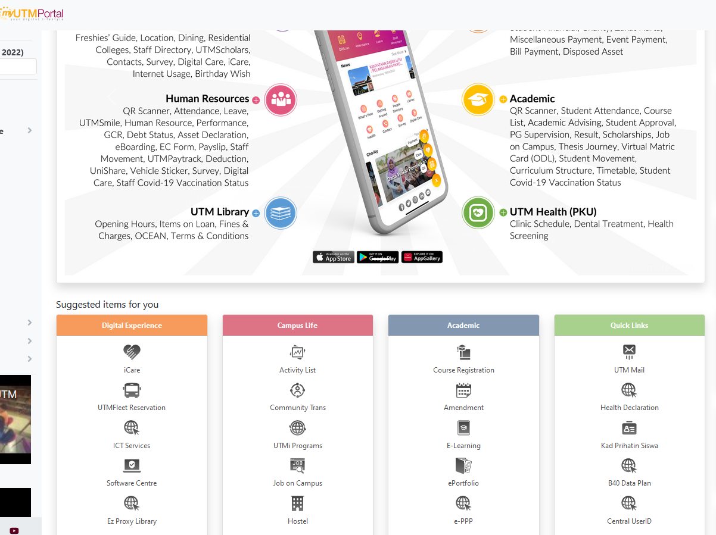
Screen Display
MyUTM
Student Portal
Click Student Portal icon

Slide 4
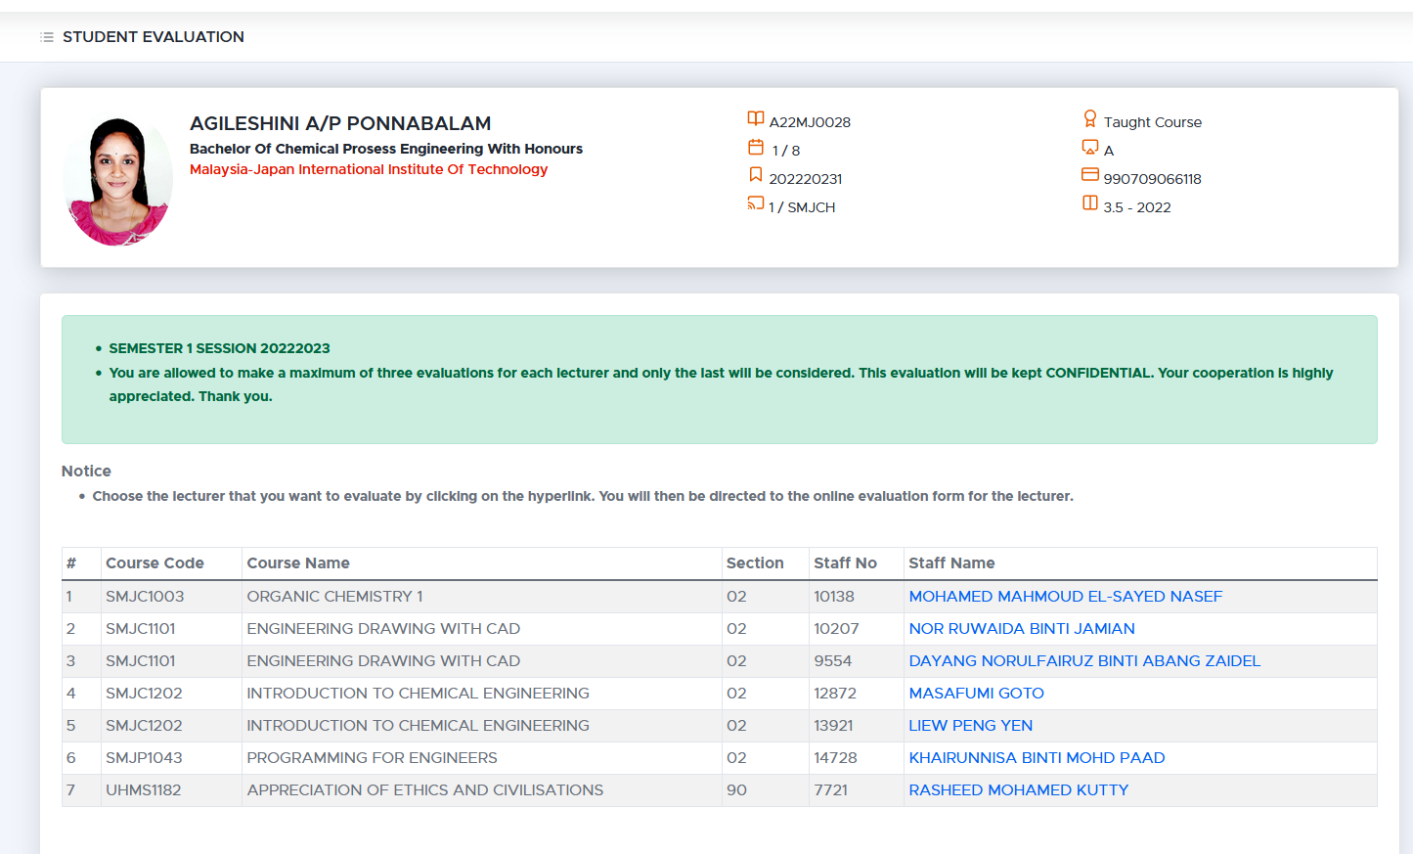

Screen Display
EPPPK
List of courses ready for evaluation
Click on the lecturer’s name for evaluation.

Slide 5
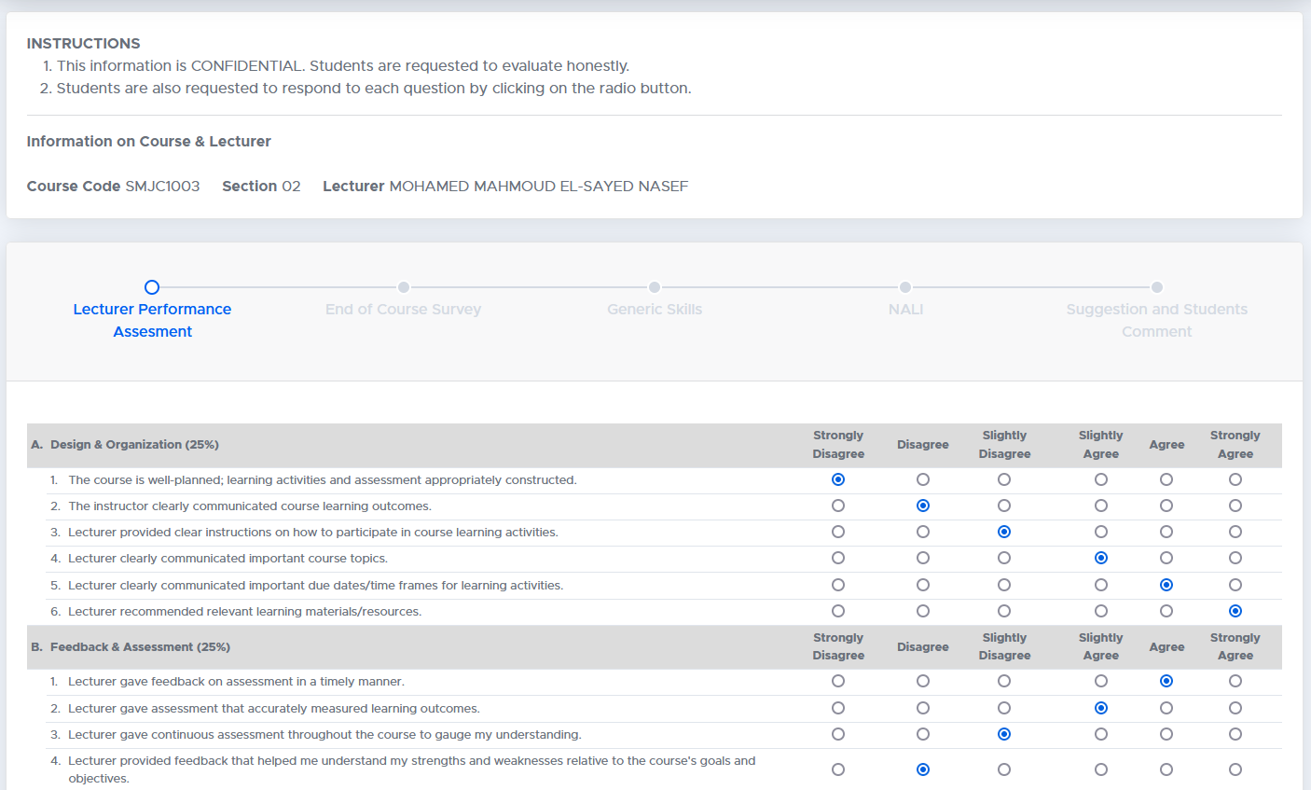
Screen Display
EPPPK
Evaluation screen
Lecturer Performance Assessment

Slide 6
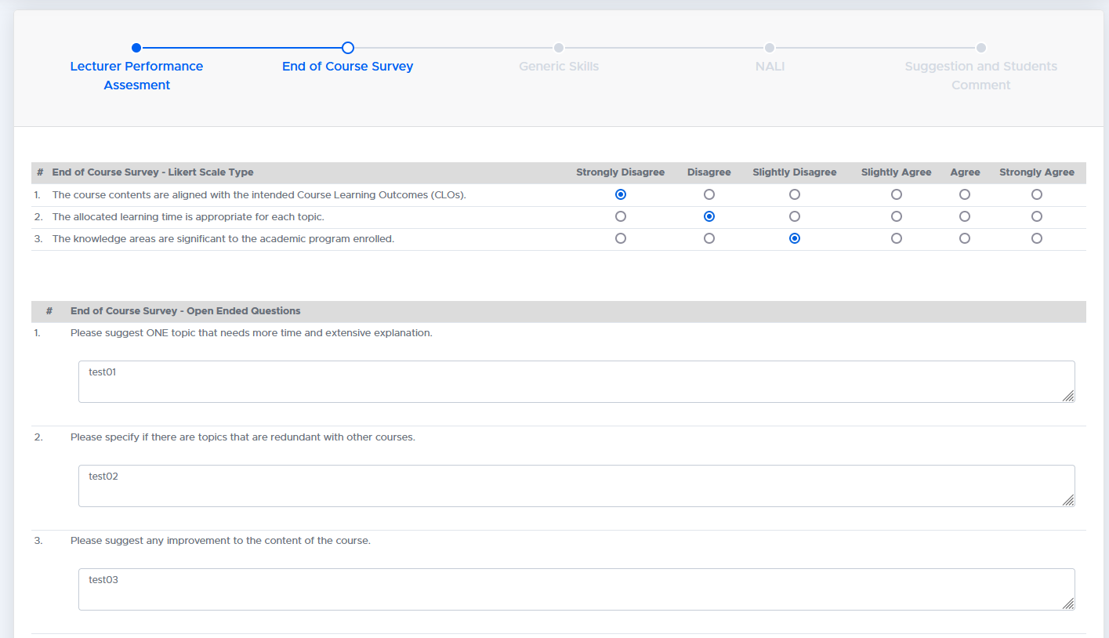
Screen Display
EPPPK
Evaluation screen
End of Course Survey

Slide 7
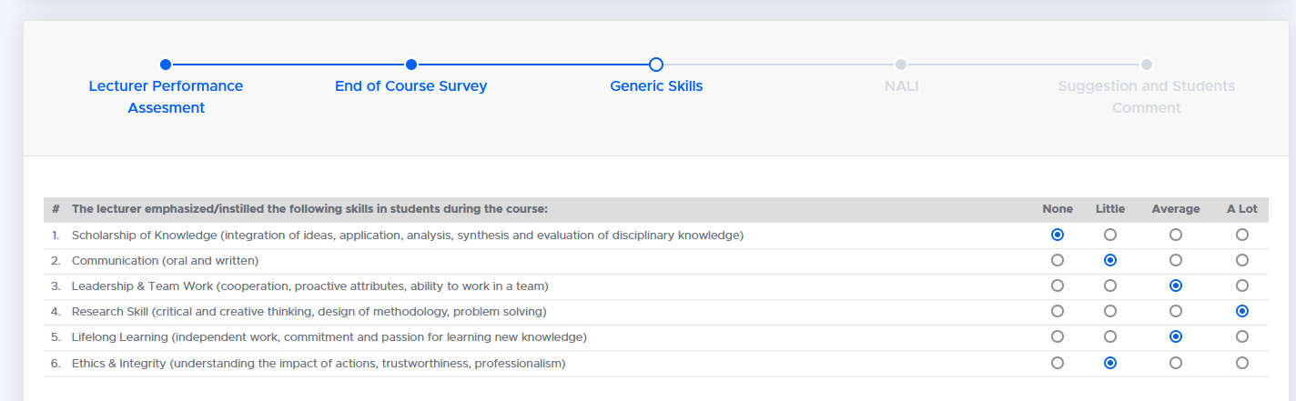
Screen Display
EPPPK
Evaluation screen
Generis Skills

Slide 8
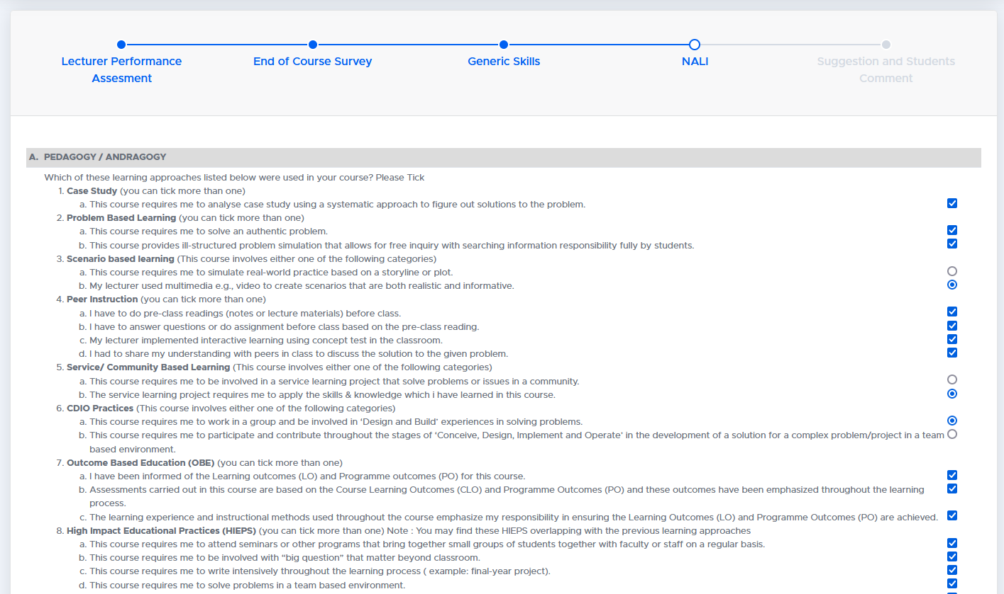
Screen Display
EPPPK
Evaluation screen
NALI Questions

Slide 9
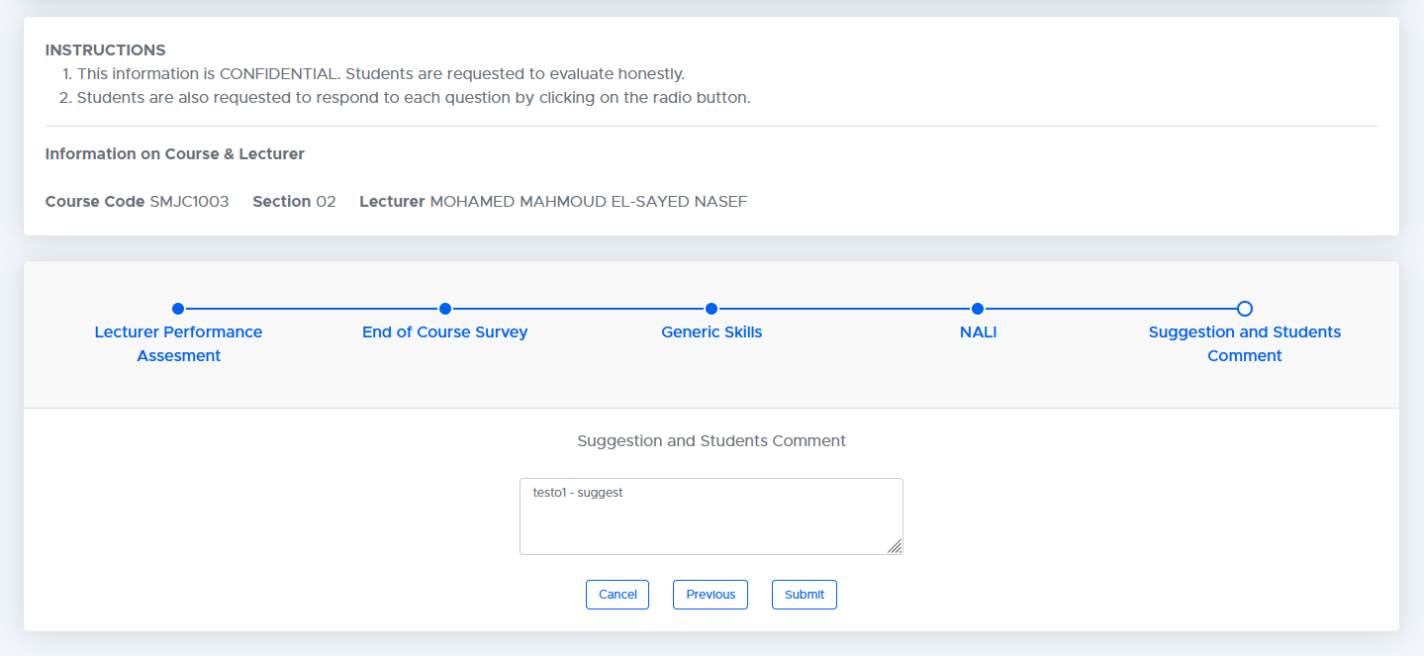
Screen Display
EPPPK
Evaluation Screen
Suggestion & Students Comments

Slide 10
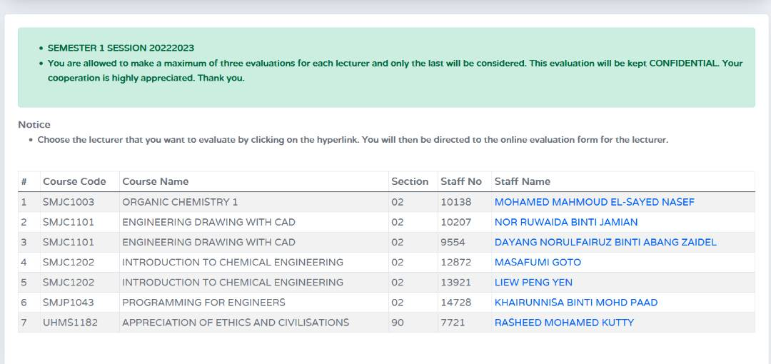
Screen Display
EPPPK
Successful Submission
After submission, student will be directed to the list of subjects.

Slide 11
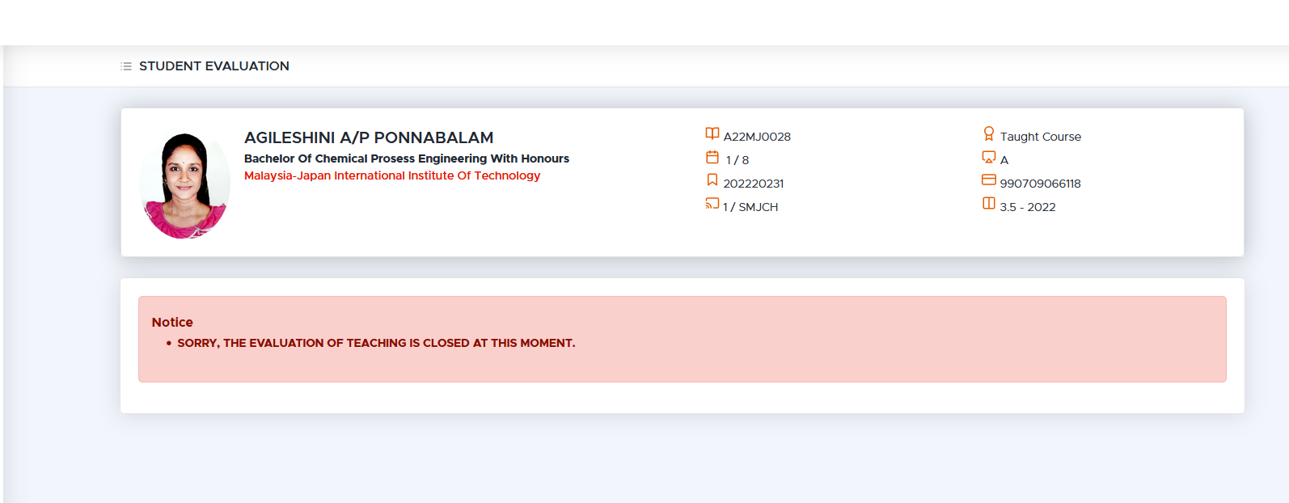
Screen Display
EPPPK
Closed evaluation period
Notification display when the evaluation period has expired

Slide 12


